Slide 1
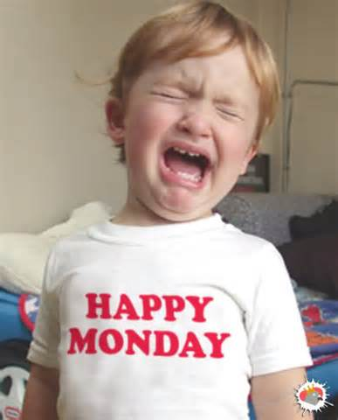

Slide 2
Stock Market Challenge
CHALLENGE DATES
September 8 to November 14, 2014

Slide 3
Teams
Need a team name.
Team Roles (Will need 2 of one role or 1 person can be a floater!)
Facilitator
Researcher
Writer
Poster Designer

Slide 4
Today:
On a sheet of paper write down:
Team name
Members and their roles.
Turn this in to the homework folder before leaving!

Slide 5
Project Assignment
At the end of the project your team will write a paper. (**Paper Requirements will come soon**)
You will be required to research your investments and be able to explain why you made these choices.
The written part of the project must show how research was done, why the stock was picked, and the results of your investment.
Your team will also need to create a tri fold poster board, highlighting your major investments, successes, and failures. (**poster requirements coming soon!**)

Slide 6
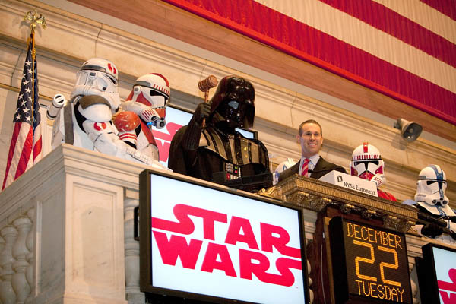
Opening Bell

